Slide 1
Hierarchical star: a new two level interconnection network
Wei Shi, Pradip K. Srimani
Journal of Systems Architecture 51 (2005) 1–14
Presenter: Chiao-Wei Chiu
Date: Dec. 5, 2007

Slide 2
Abstract
We propose a new two level interconnection network topology, hierarchical star networks, HS_{n}, that uses the star graphs as building blocks. Two level networks have been previously proposed that use hypercube and its variants as building blocks; it has been shown that these two level networks are superior to the networks, that are used as building blocks, in terms of various performance metrics including diameter, cost, fault tolerance, fault diameter etc.

Slide 3
Abstract (cont.)
Our results show that the proposed family of hierarchical star networks perform very competitively in comparison to star graphs; in addition, the proposed network outperforms all of the two level hierarchical networks proposed earlier that uses hypercubes (or its variations) as building blocks.

Slide 4
Abstract (cont.)
Thus, our results further reinforce the notion that the star graphs are strong competitors of hypercubes for large multiprocessor design. We also investigate various topological properties of the network including embedding, mapping of parallel algorithms, fault tolerance and broadcasting algorithms.

Slide 5
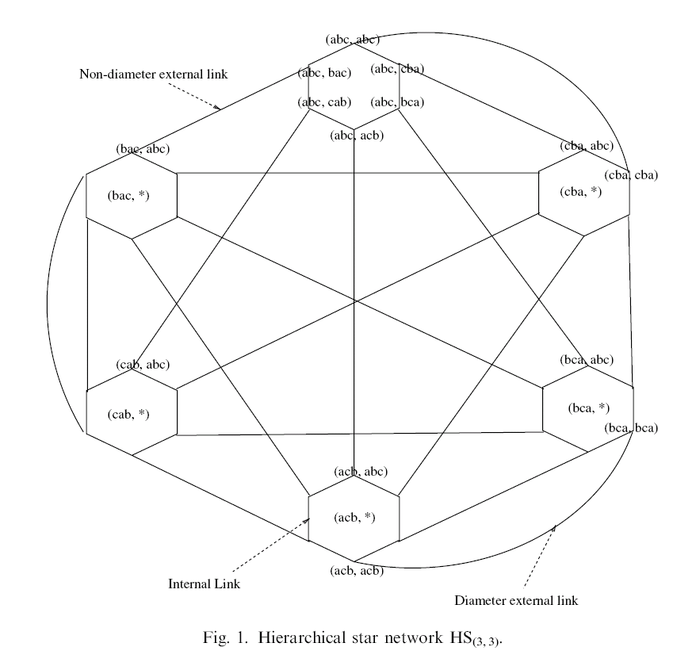

Slide 6



Nodes and edges
n-1 local links
1 external link

Slide 7
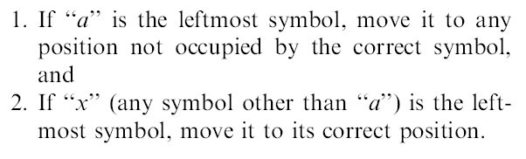
Routing in star graph
Algorithm Star_Route
In n-star graph, D(u, v) ≦ 3(n - 1)/2

Slide 8

Routing in HS_{(n, n)}
In HS_{(n, n)}
Consider nodes (u_{s}, v_{s}) and (u_{d}, v_{d}) in HS_{(n, n)}
u_{s} ＝ u_{d} , use Star_Route
u_{s} ≠ u_{d}
  Algorithm Simple_Route
  Path P1:
  Path P2:

Slide 9
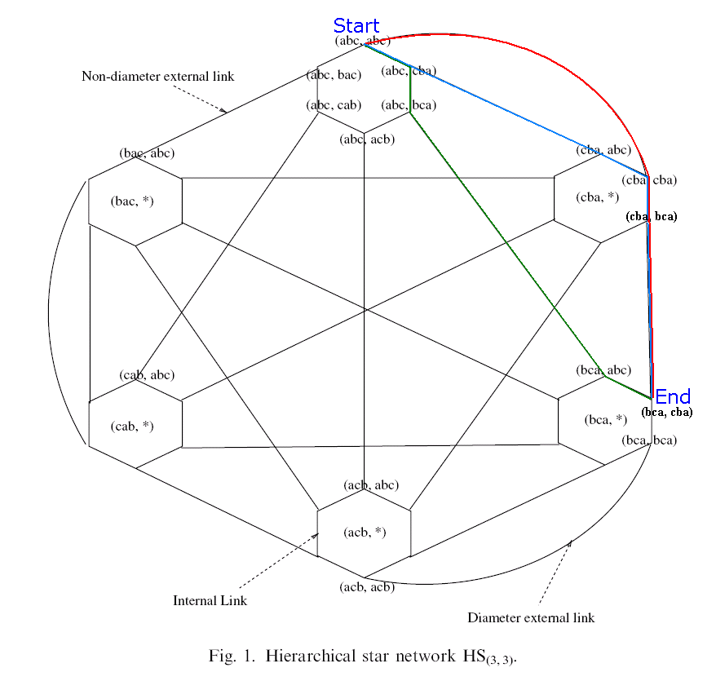
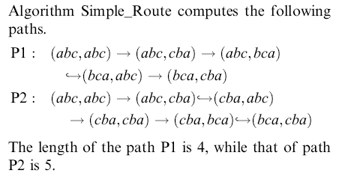

Example
The shortest path is

Slide 10
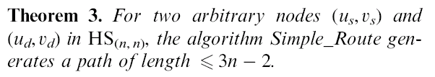

Path and diameter

Slide 11
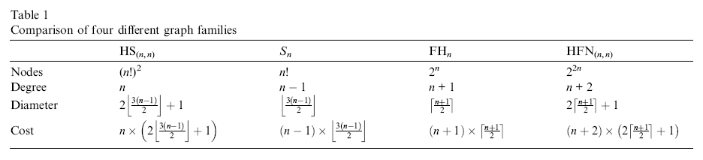
Comparison with other networks

Slide 12
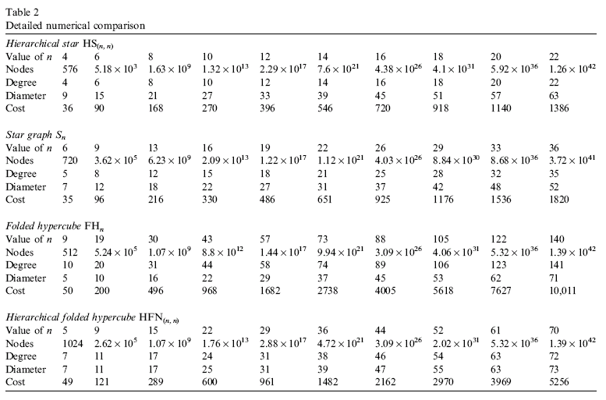
Comparison (cont.)

Slide 13
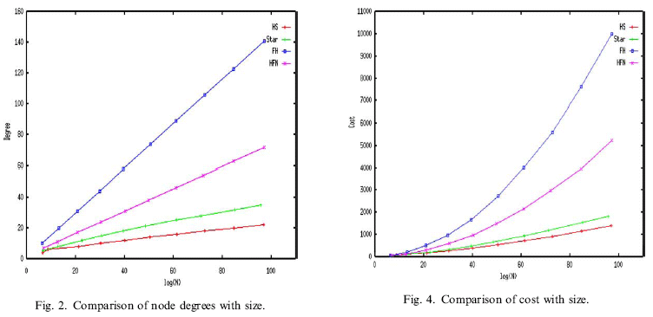
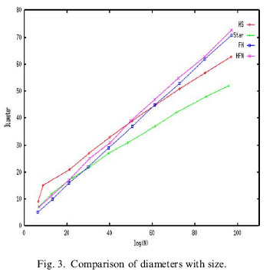

Slide 14
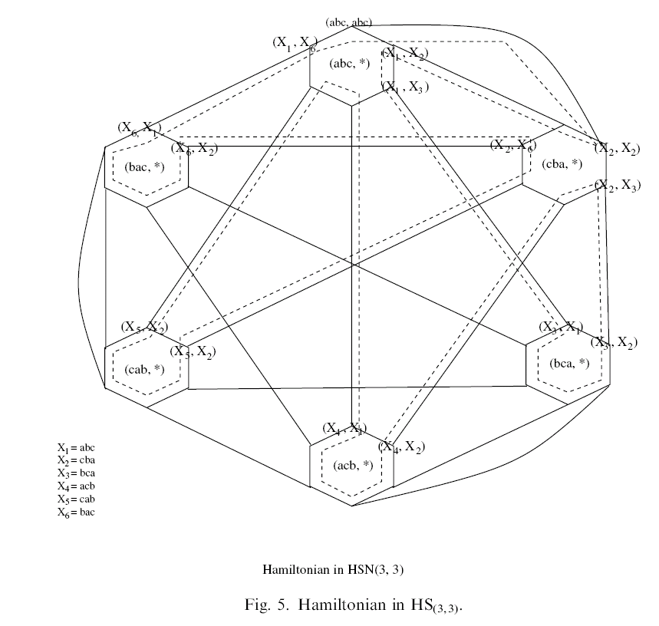

Cycles in HS_{(n, n)}

Slide 15
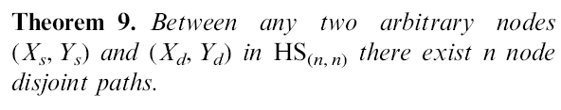
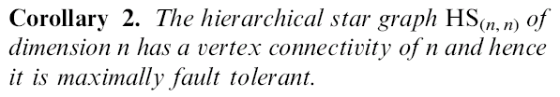
Fault tolerance of HS_{(n, n)}

Slide 16
One-to-all broadcast in HS_{(n, n)}
Step 1: (x,y) to (x,*)
O(nlogn)
Step 2: (x,u) to (u,x)
O(1)
Step 3: (u,x) to (u,*)
O(nlogn)
N = (n!)²
O(logN) = O(nlogn)

